Slide 1
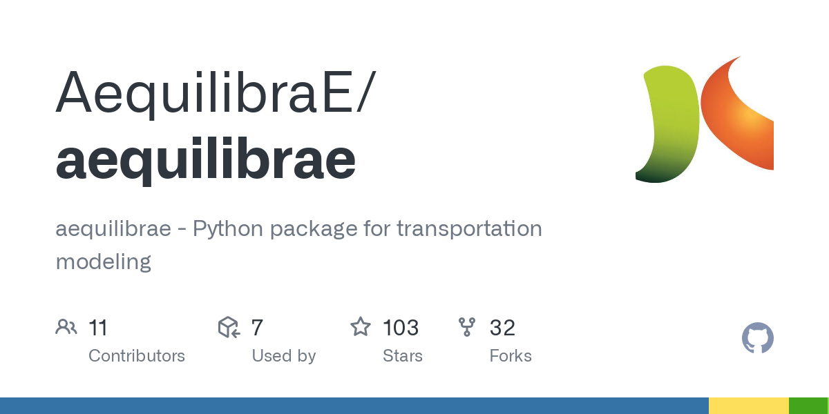
Using AequilibraE
for Teaching 4-Step Process in
Transportation Network Modeling
Version 1: 03/10/2023
Version 2: 01/20/2024
Authors: chongnanli1997@hotmail.com, xzhou74@asu.edu

Slide 2
What is AequilibraE?
AequilibraE is the first comprehensive Python package for transportation modeling, and it aims to provide all the resources not easily available from other open-source packages in the Python ecosystem or for any Open-Source GIS package, such as QGIS.
User guide for AequilibraE package
http://www.aequilibrae.com/qgis/V.0.6.1/
Comprehensive Transportation Modeling: AequilibraE is an all-in-one Python package for transportation planning and modeling.
Widespread Use and Community Engagement: Over 300K downloads, 500+ daily, with strong community support via guidelines and a Google Groups email list.
User-Friendly and Accessible: Easily downloadable from PyPI, filling a niche not covered by other open-source Python or GIS tools.
Practical, Tested Applications: Features data from the Chicago regional model and supports various planning tasks like shortest path computation and traffic assignment.

Slide 3
Advanced Features of AequilibraE
Open Street Maps (OSM) Projects: Despite certain integration difficulties with OSMNx due to its dependencies, AequilibraE skillfully handles OSM data, effortlessly transforming it into an efficient TranspoNet format.
GMNS Format Compatibility: The library supports users to import from the General Modeling Network Specification (GMNS), facilitating interoperability among various transportation software applications. AequilibraE's models can also be exported in the GMNS format, making data exchange and integration with other software solutions seamless.
Customizable VDF Parameters: AequilibraE allows users to adjust Volume-Delay Function (VDF) parameters according to individual or overall network link requirements, enhancing the accuracy of the modeling process. It provides an array of VDF functions essential for evaluating the impact of traffic flow on link delays.
Multi-class Equilibrium Assignment: With AequilibraE, users have access to an advanced feature that facilitates complex multi-class traffic assignments. This feature adheres to stringent technical specifications for formulating the multi-class equilibrium assignment as a constrained convex optimization problem. It supports several algorithms, including the Method of Successive Averages and various versions of Frank-Wolfe algorithms.

Slide 4
References of AequilibraE
Camargo P (2015) AequilibraE: a free QGIS add-on for transportation modeling. Foss4g North America
QGIS package: http://www.aequilibrae.com/qgis
PyPI link: https://pypi.org/project/aequilibrae
Google Colab notebook: https://colab.research.google.com/github/outerl/AequilibraE-demo/blob/main/basic_aequilibrae_demo.ipynb
Python package download statistics: PePy - aequilibrae Download Stats

Slide 5
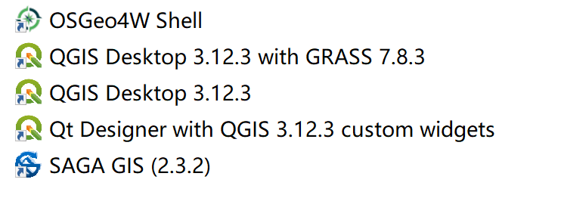
Installation of AequilibraE
First of all, install open-source software: QGIS.
In my computer, the version is 3.12.3. My computer’s operating system is Windows 10.
Then, install AequilibraE as a plugin according to this step-by-step tutorial:
http://www.aequilibrae.com/qgis/V.0.6.1/installation.html

Slide 6
Installation of AequilibraE
First of all, install open-source software: QGIS.
In my computer, the version is 3.12.3. My computer’s operating system is Windows 10.
Then, install AequilibraE as a plugin according to this step-by-step tutorial:
http://www.aequilibrae.com/qgis/V.0.6.1/installation.html

Slide 7
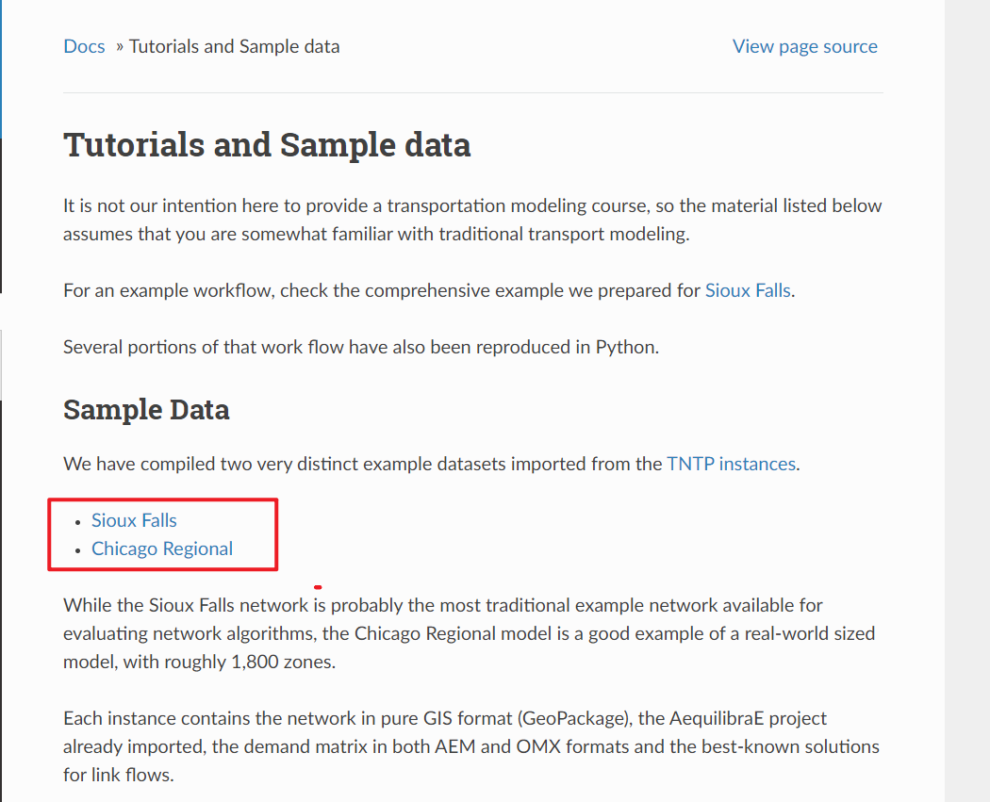
Sample data downloading
Please enter this website:
http://www.aequilibrae.com/qgis/V.0.6.1/tutorials_and_sample_data.html
Click these two super links to download Sioux Falls and Chicago regional data.

Slide 8
Getting started with Sioux Falls
The full workflow with Sioux Falls is given in this website:
http://www.aequilibrae.com/qgis/V.0.6.1/SiouxFalls.html
Let us reproduce the steps in this website.

Slide 9
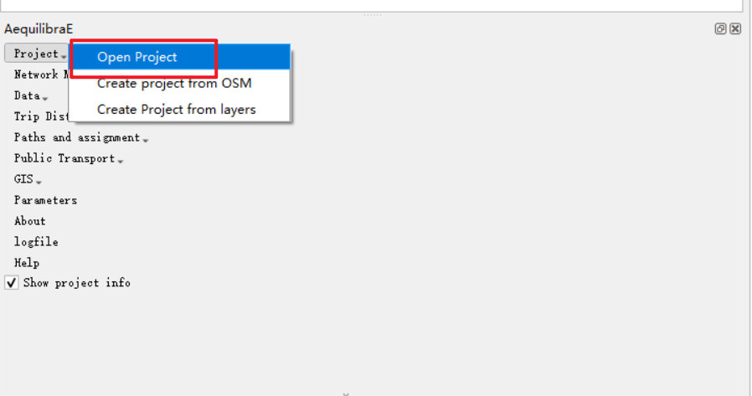
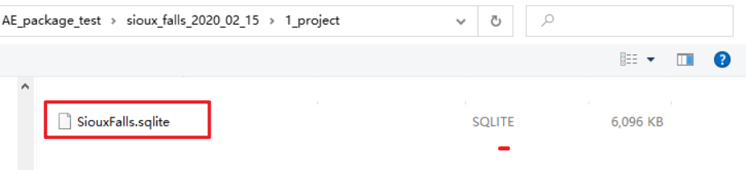
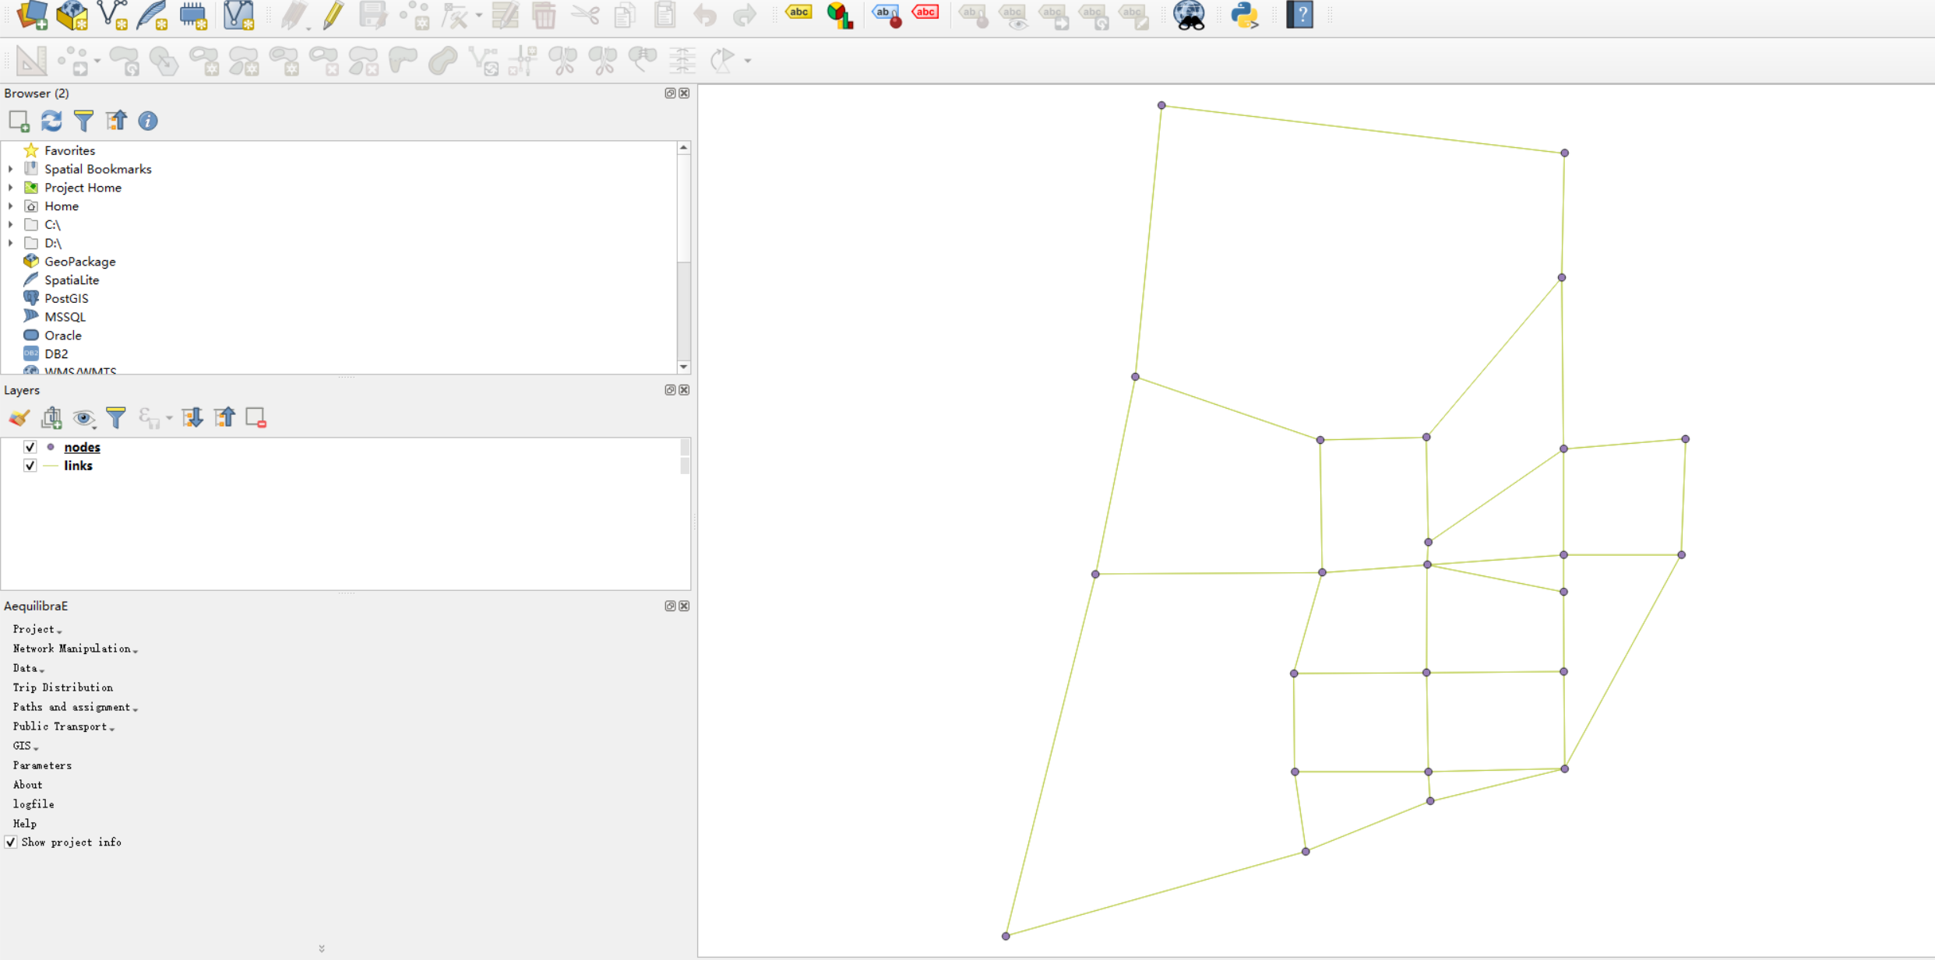
Creating a project
Two layers are obtained.
You can use “Create Project from OSM”
to generate your own data. Besides, you
can use OSM2GMNS to generate node.csv
and link.csv and load two csv files into QGIS
as two layers.

Slide 10
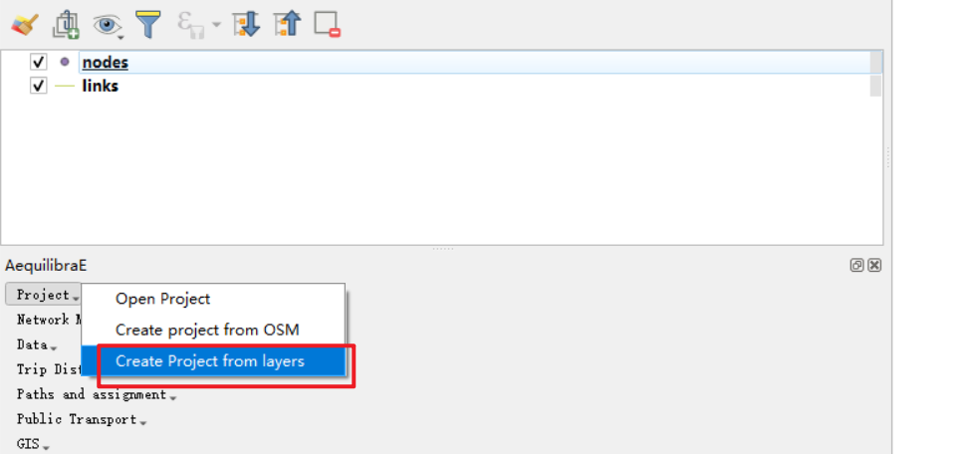
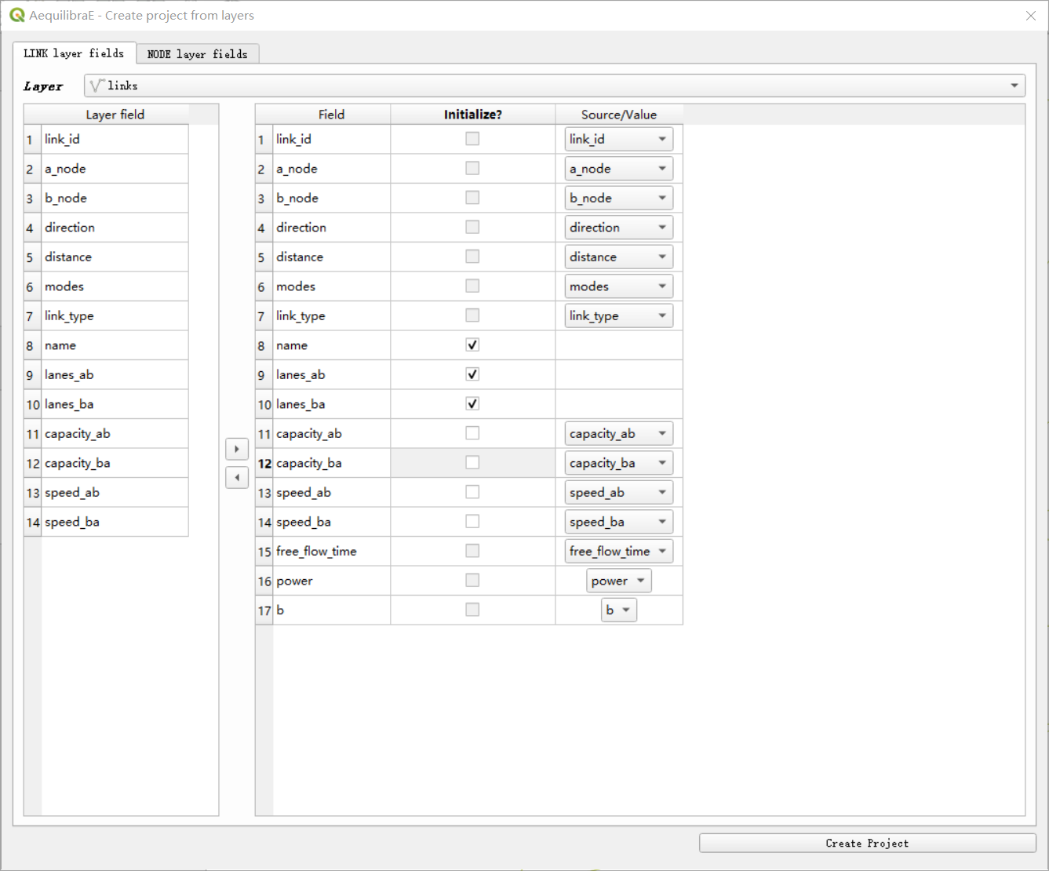
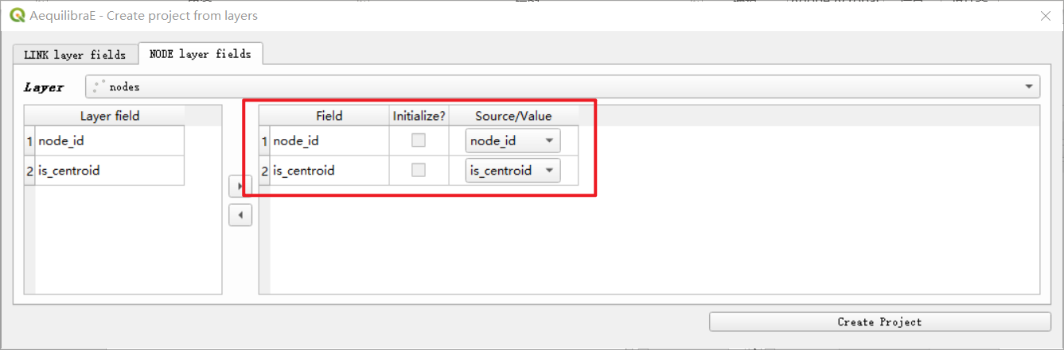
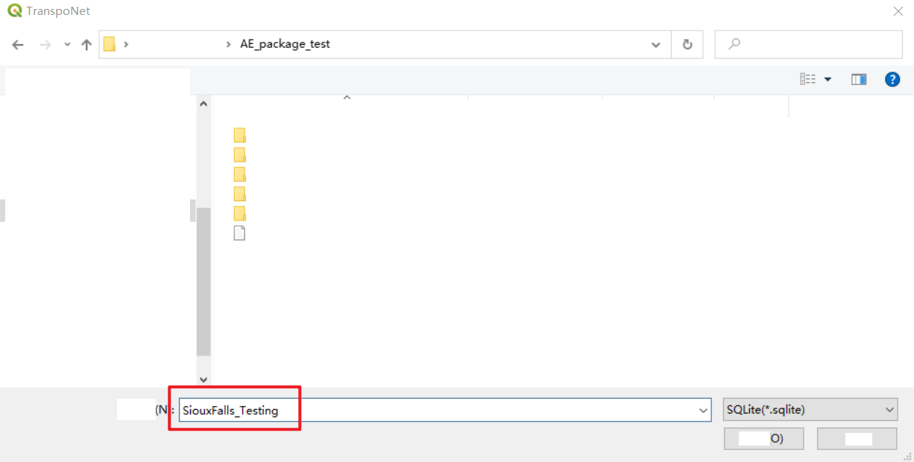
Creating a project (Cont.)
Create Project from layers
Configure fields
Save your project in SQLite format.

Slide 11
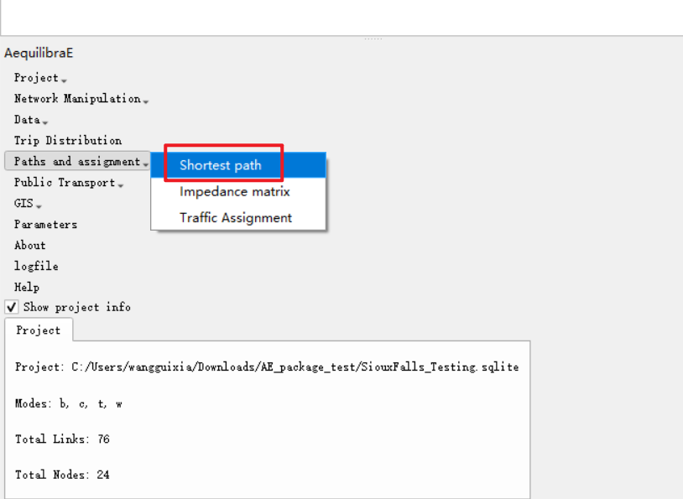
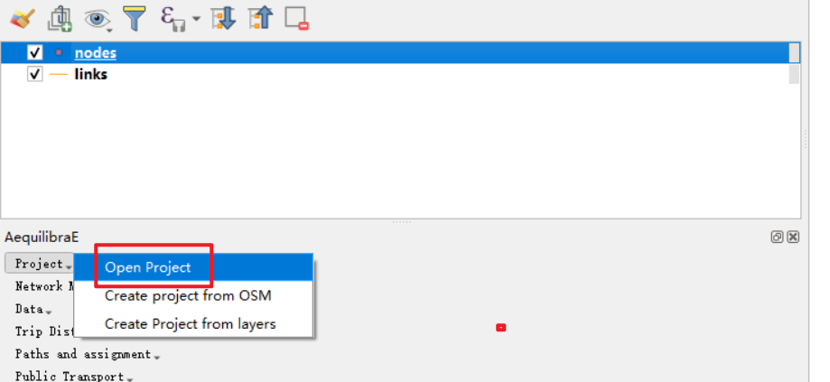
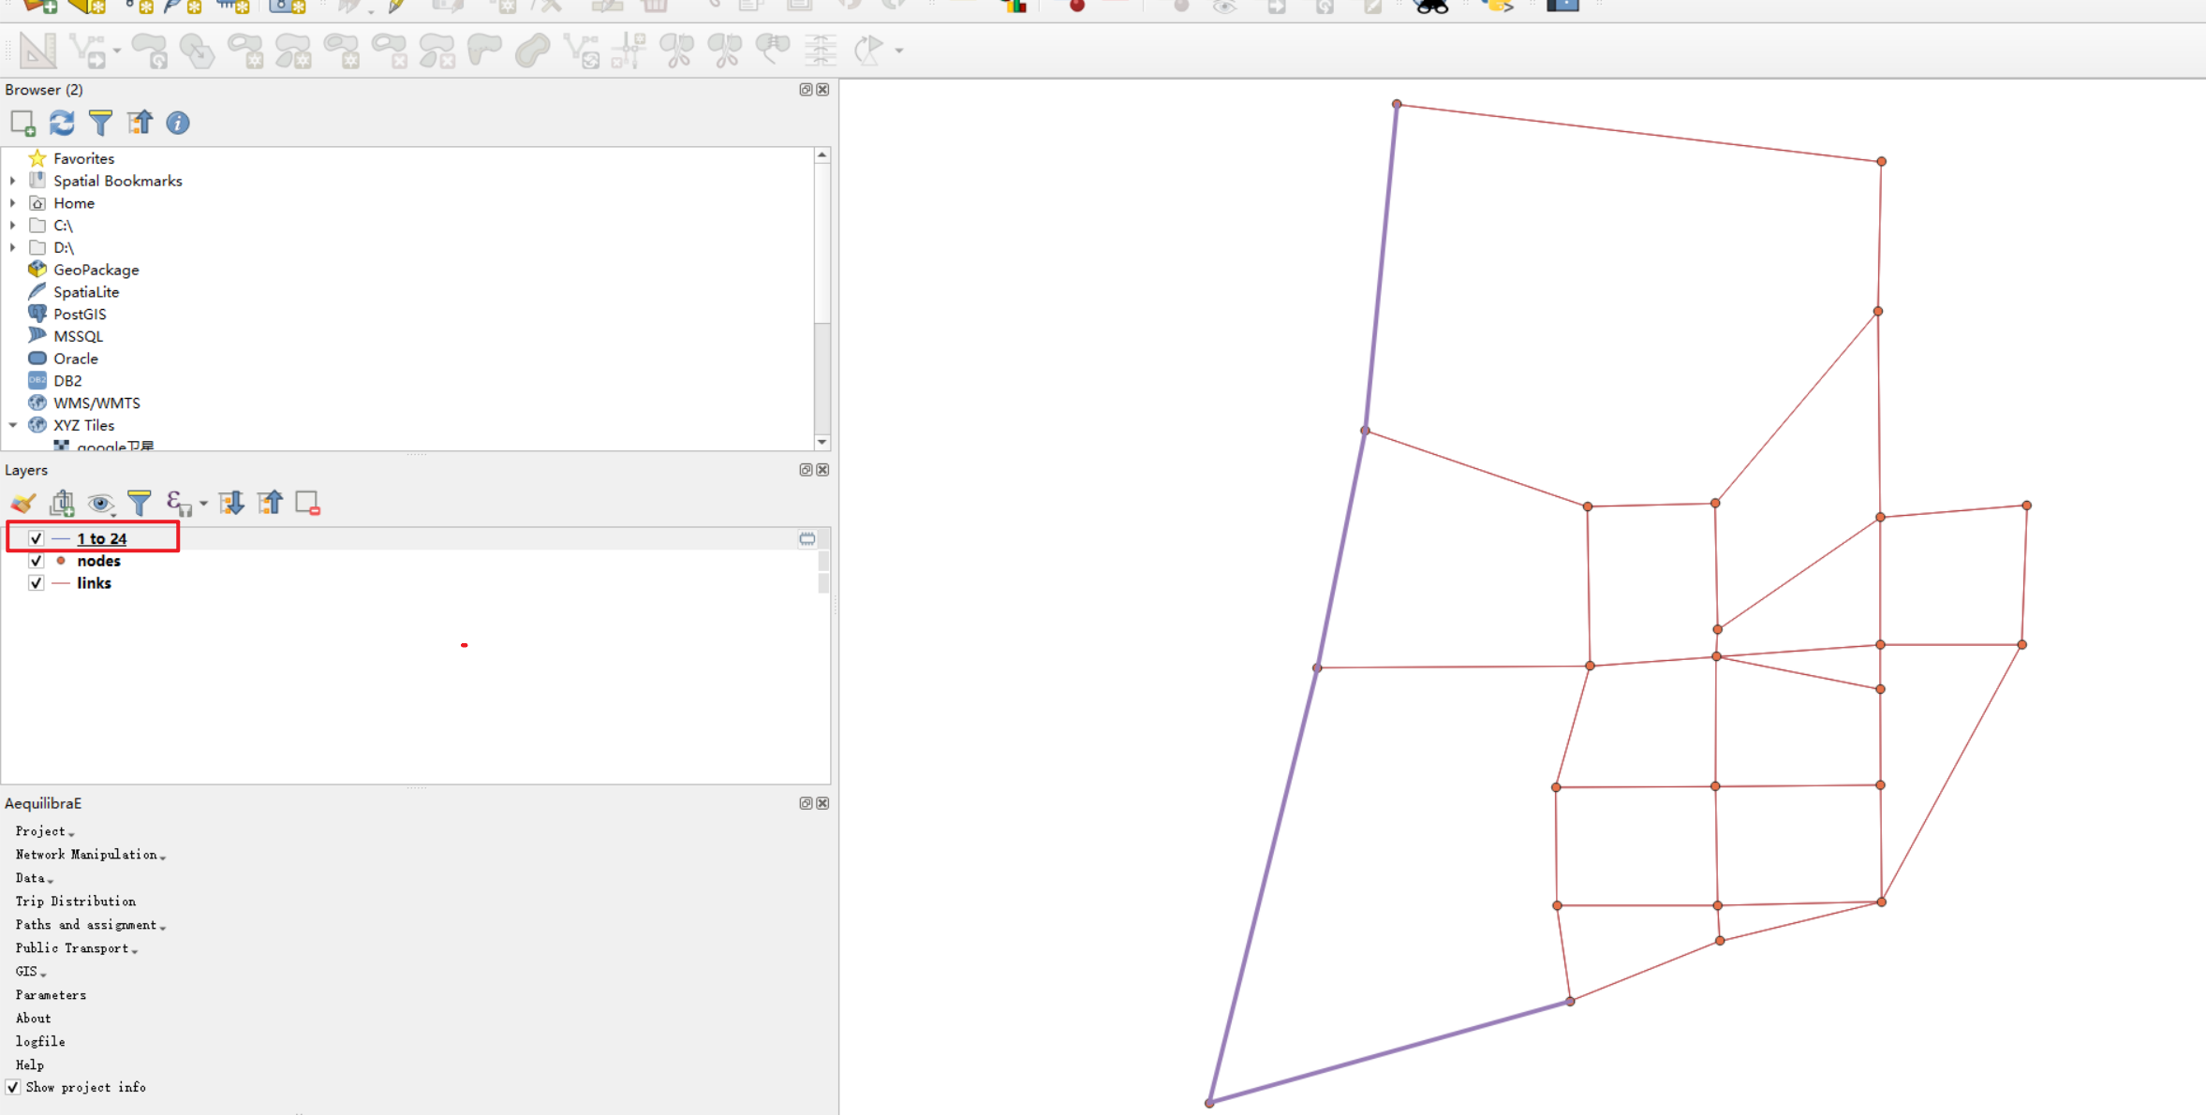
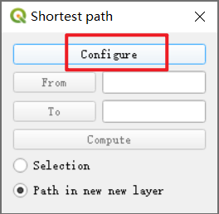
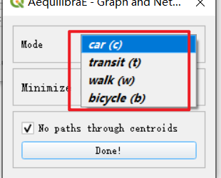
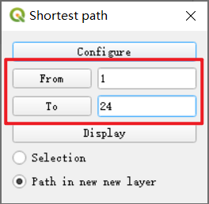
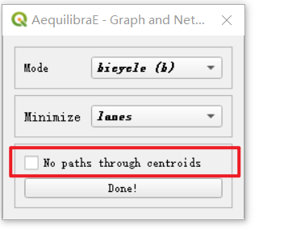
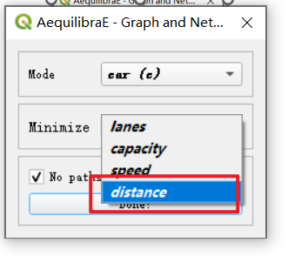
Shortest path computation

Slide 12
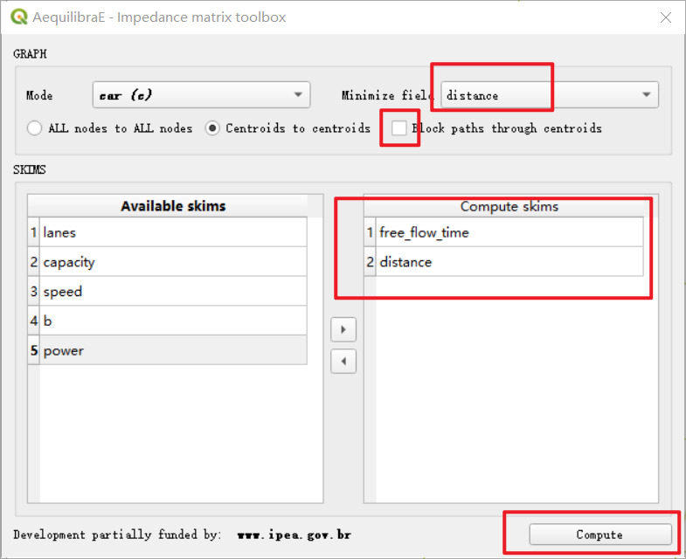
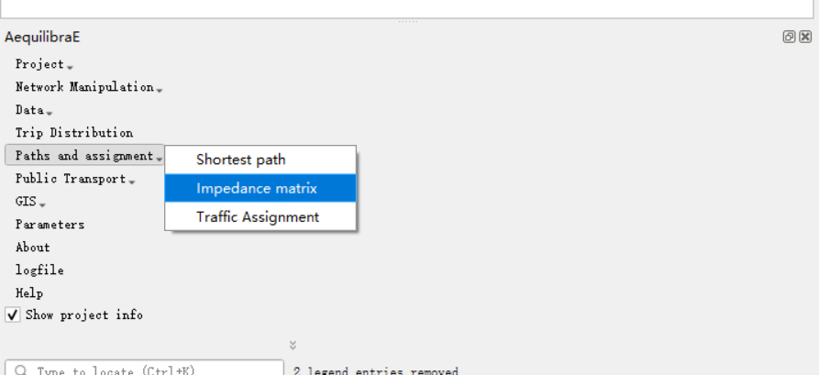
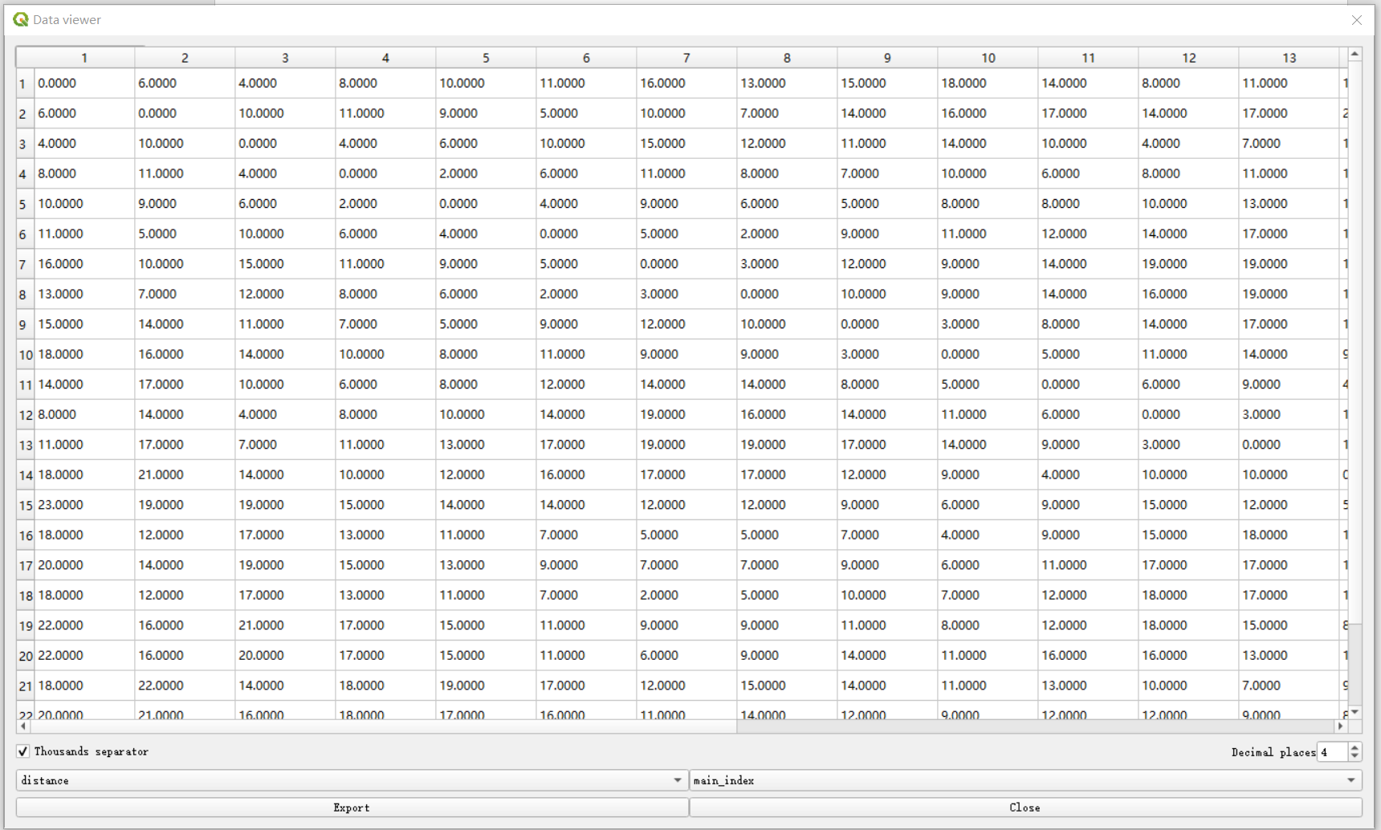
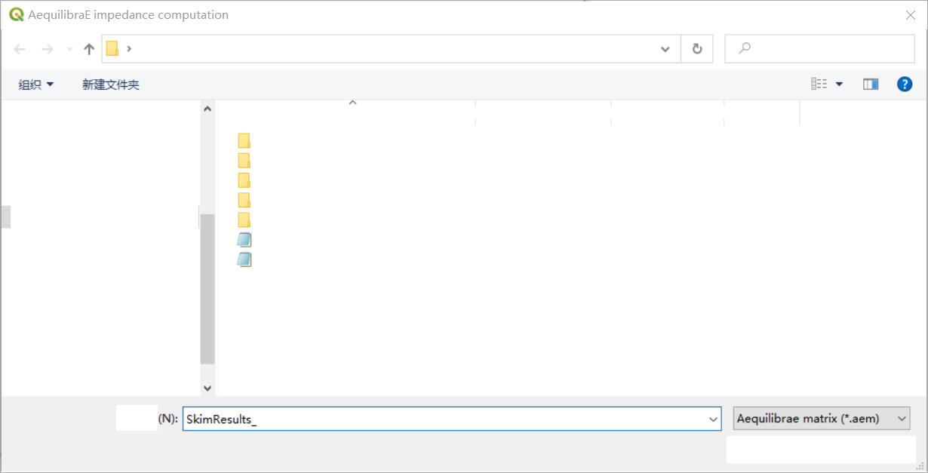
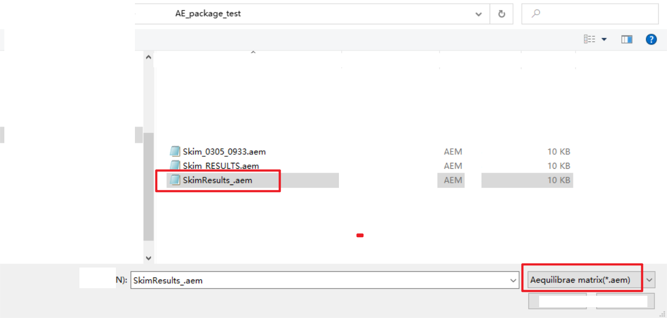
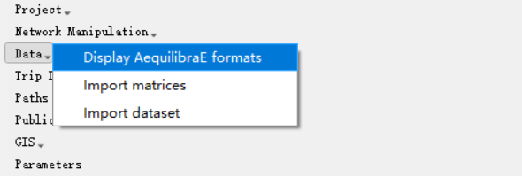
Skimming

Slide 13
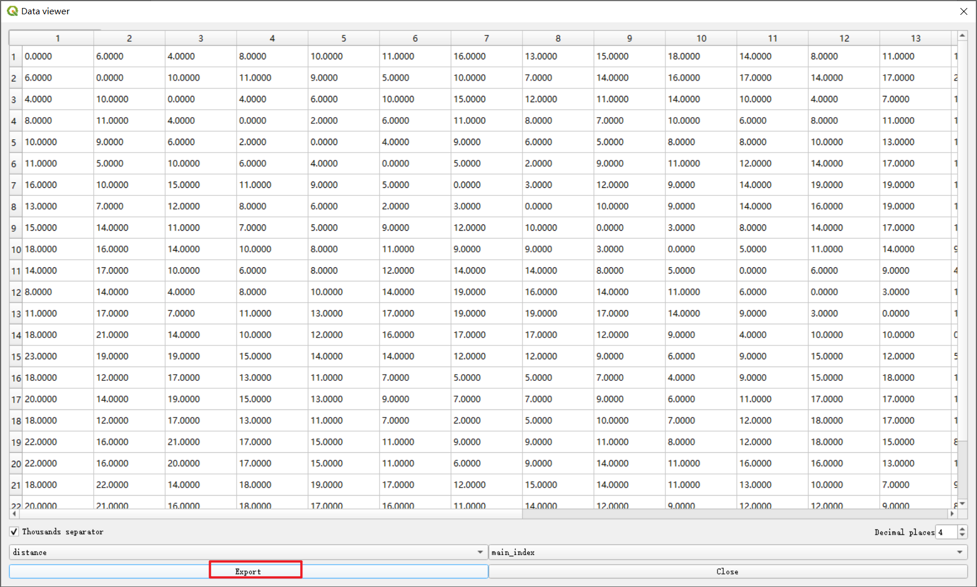
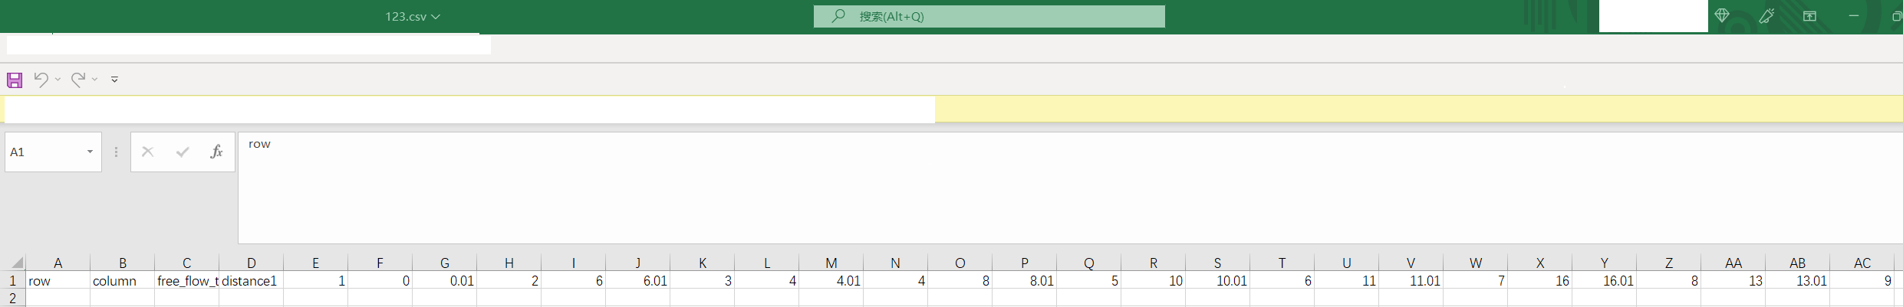
Skimming
Exporting skimming results into CSV.
All data is aligned in a line.

Slide 14
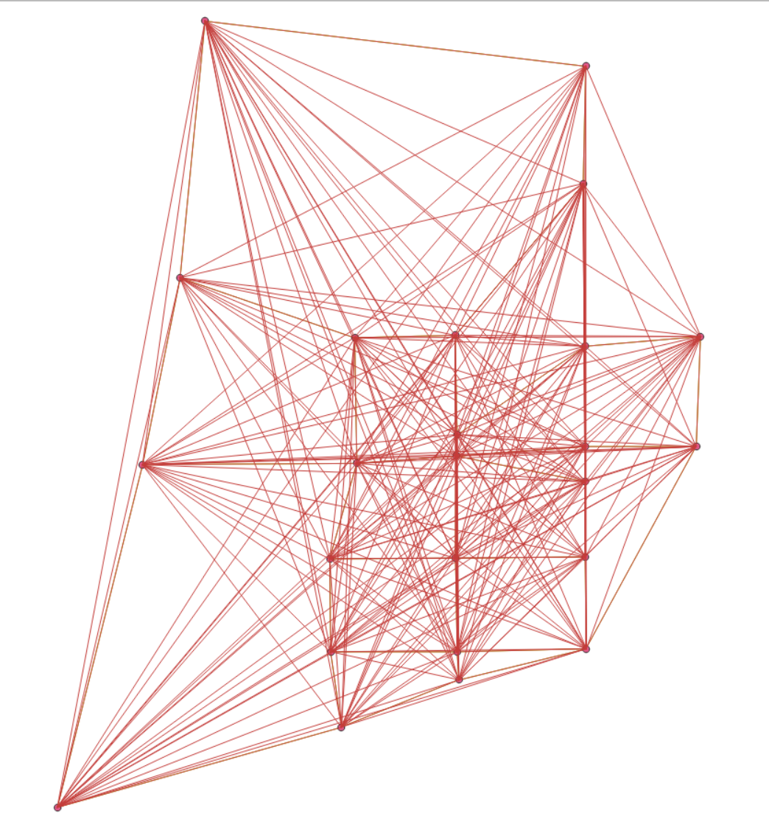
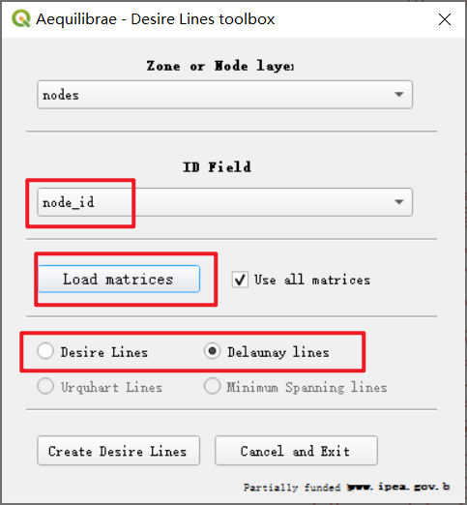
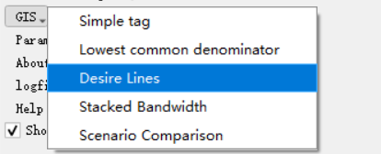
Desire Lines
Question 1: I still don’t understand the difference between desire lines and delaunay lines
Question 2: My reproduced lines are with the same width. How can I generate lines with various width?

Slide 15
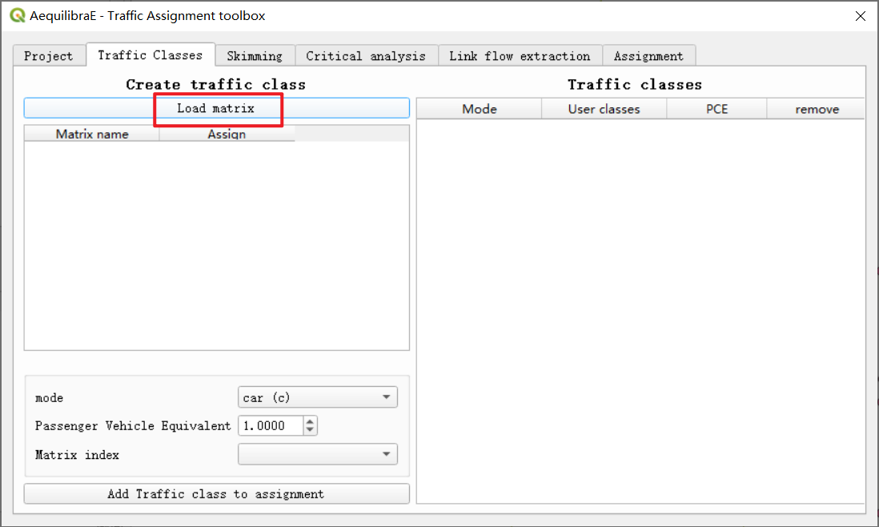
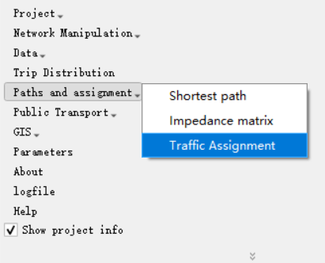
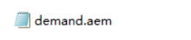
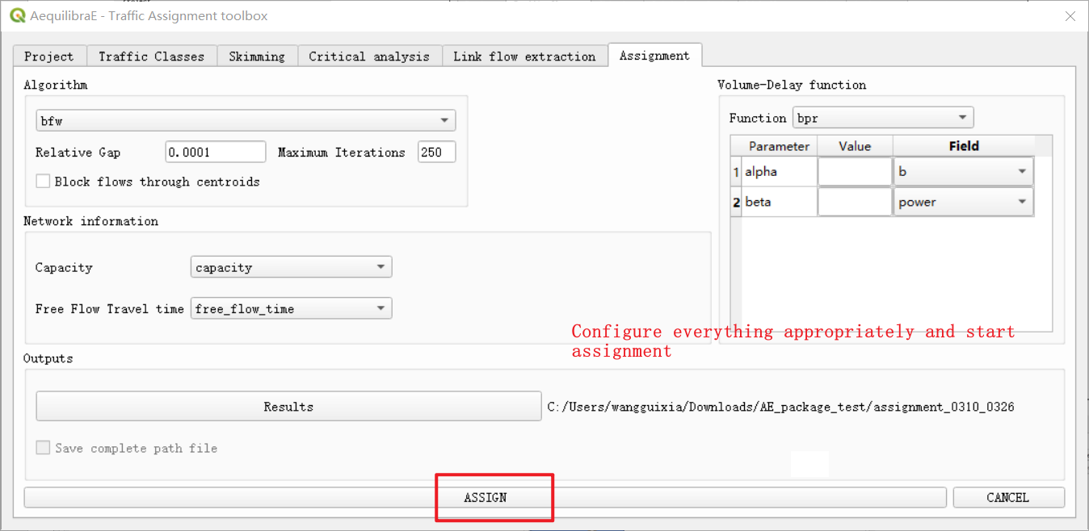
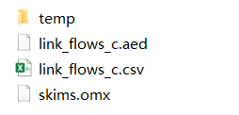
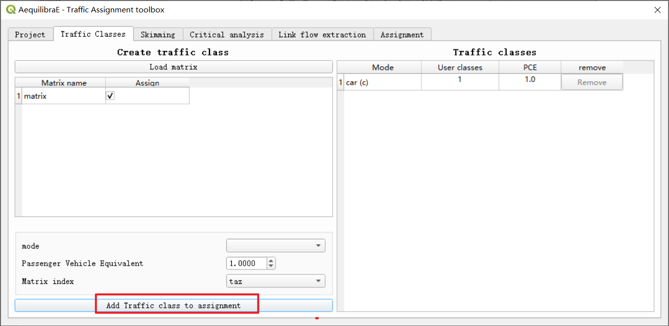
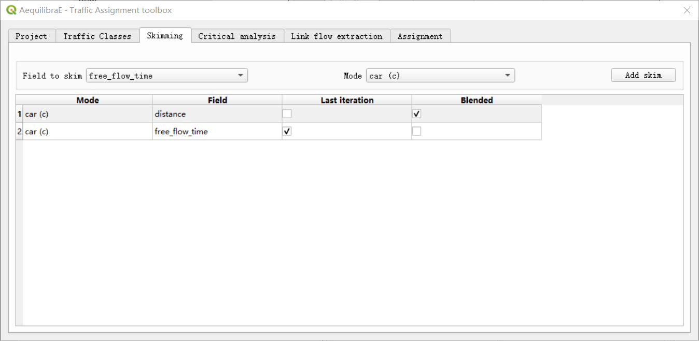
Traffic assignment with skimming
Load demand.aem as demand information.

Slide 16
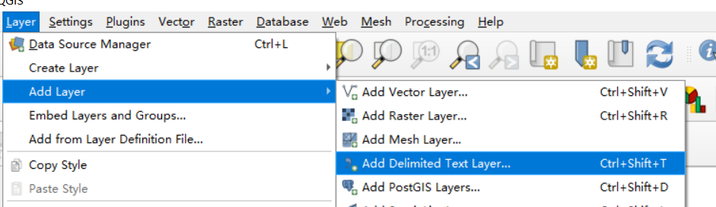
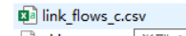
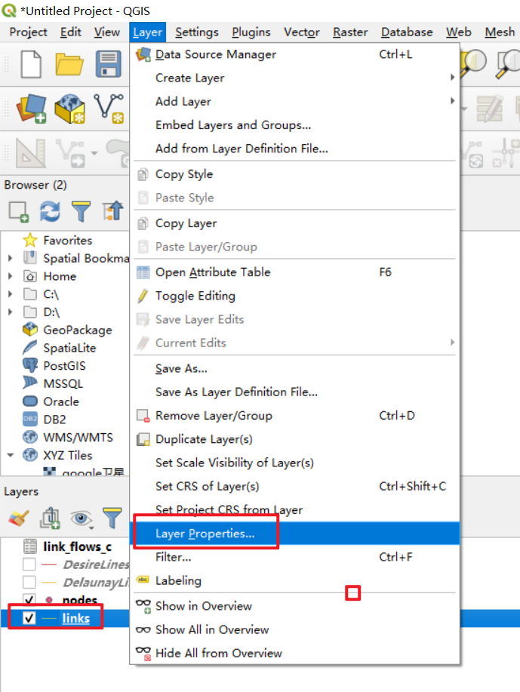
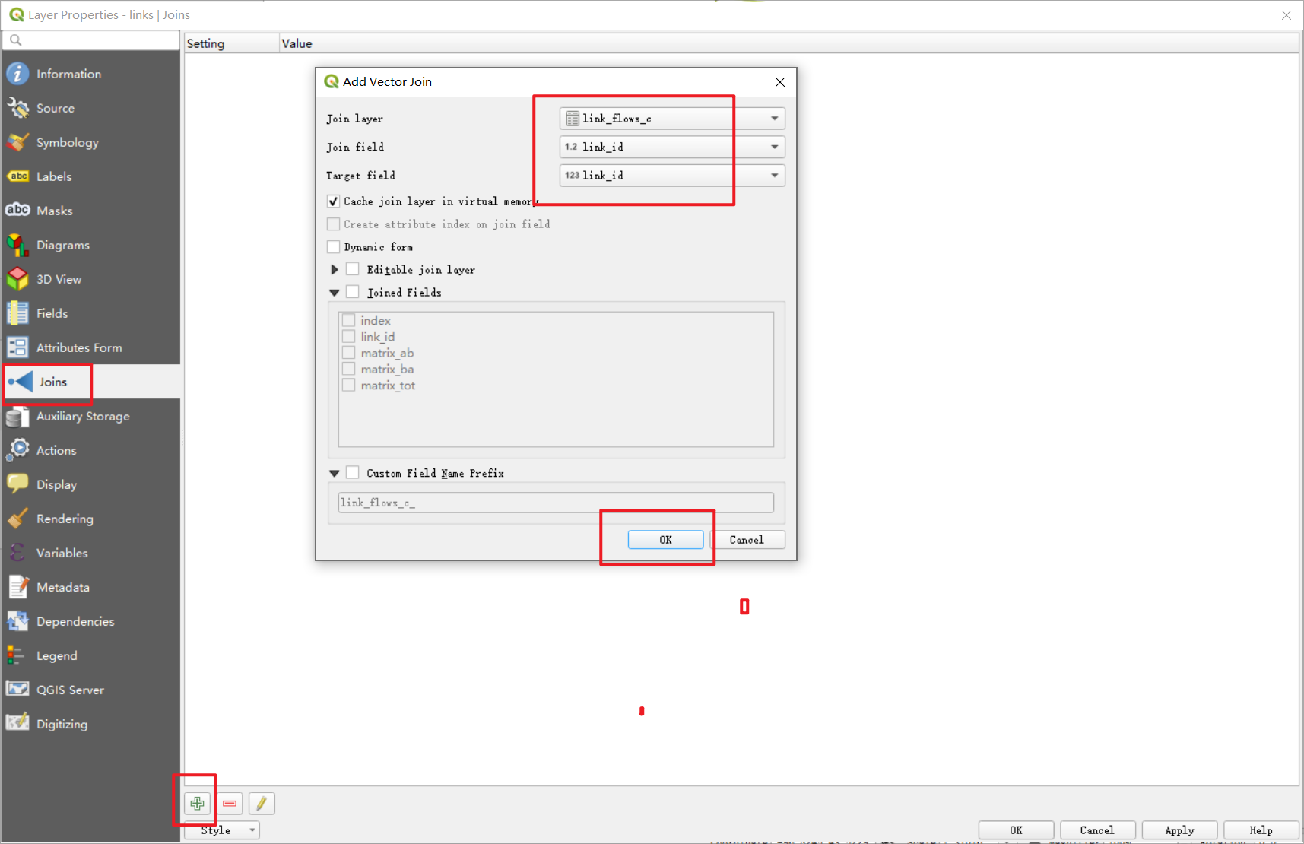
Flow plotting
Load link flow information which is stored in CSV format.
Generate connection between the loaded data and link layer.

Slide 17
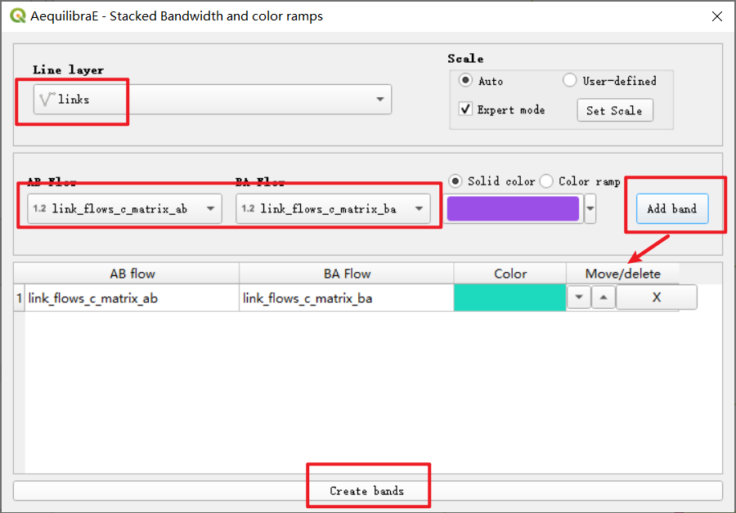
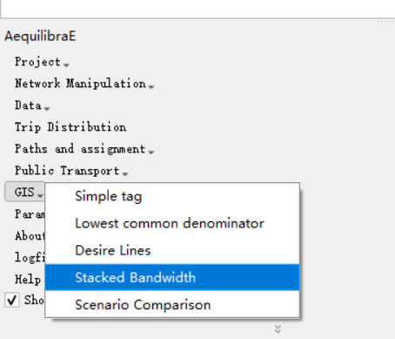
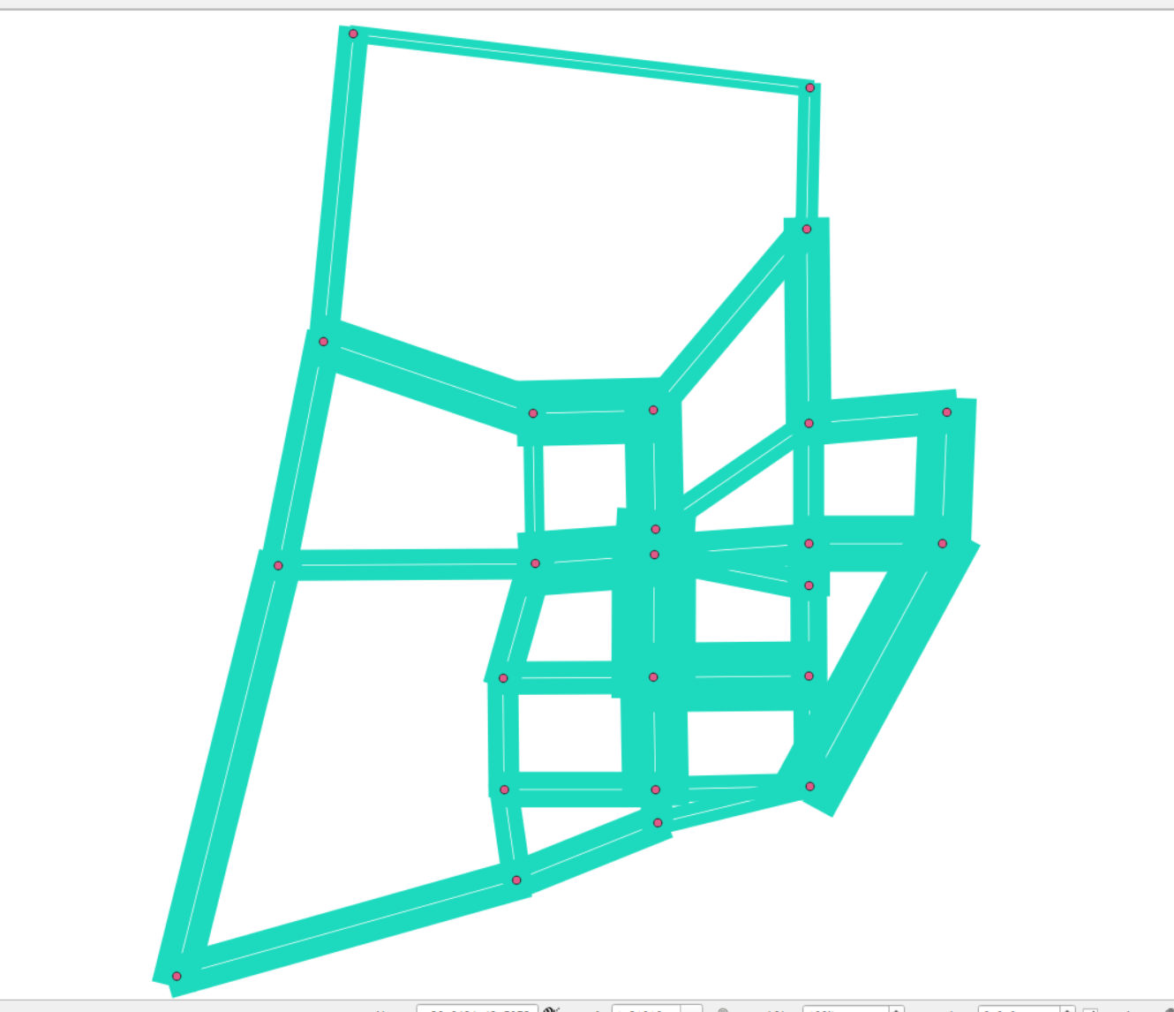
Flow plotting (Cont.)

Slide 18
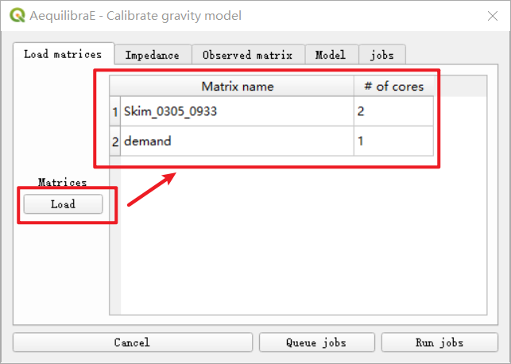
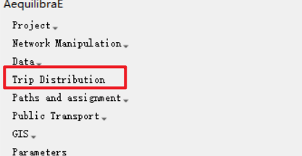
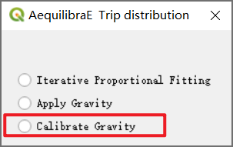
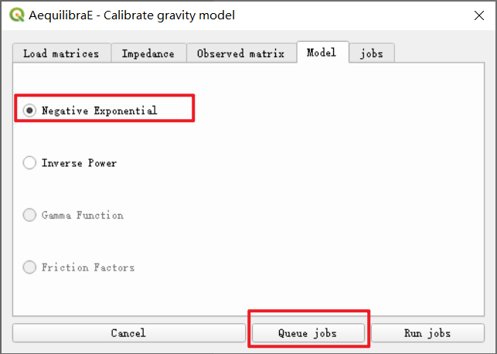
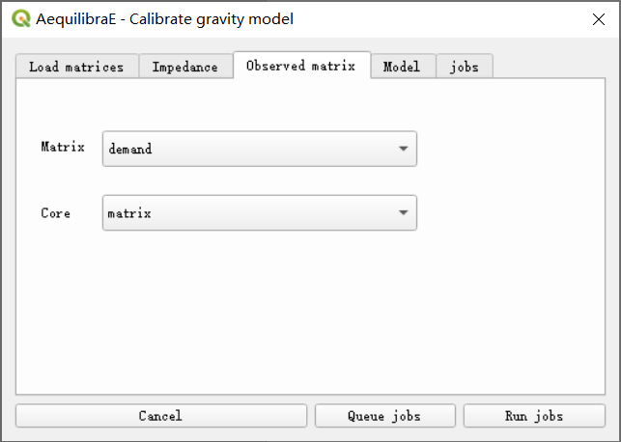
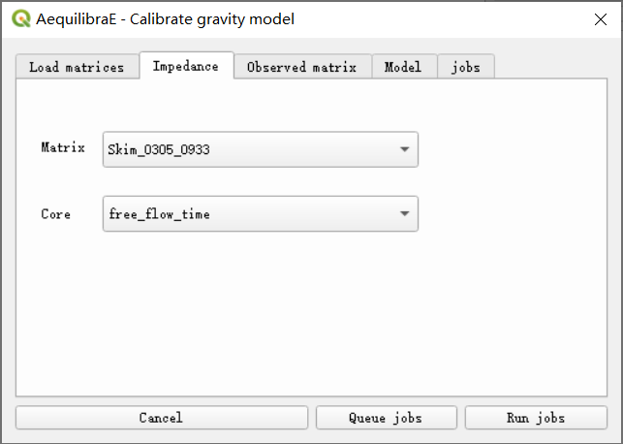
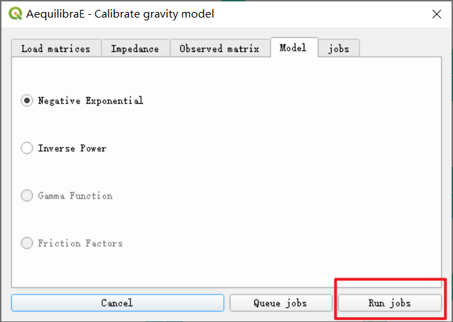

Gravity model calibration

Slide 19









Forecast

Slide 20


Forecast (Cont.)
Exporting forecasting results into CSV.

Slide 21




Scenario comparison
Load link flow information in the future
And associate the information with the link layer.

Slide 22


In AequilibraE panel, you can use Display AequilibraE formats for
visualizing data files.
It supports reading three types of files: omx, aem, and aed.

Slide 23


Now, let us use this data visualization to see demand file used in Sioux Falls example:
As you can see, this file is a 24 by 24 matrix.

Slide 24




Let us make a simple demand file under GMNS and store the file as a CSV.
Load this CSV into our QGIS project as a layer.
Select Import matrices.

Slide 25



Configure – Load - Save.

Slide 26

You can use Display AequilibraE formats again
You can see it does not fill zero for unconfigured cells.

